Slide 1


DAY2
Introduction to NGS technologies and library preparation
Chiara Batini, cb334@le.ac.uk

Slide 2
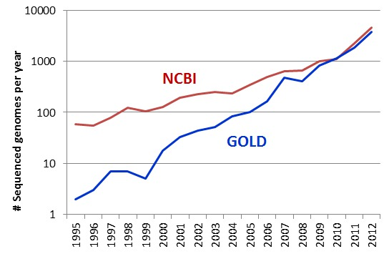
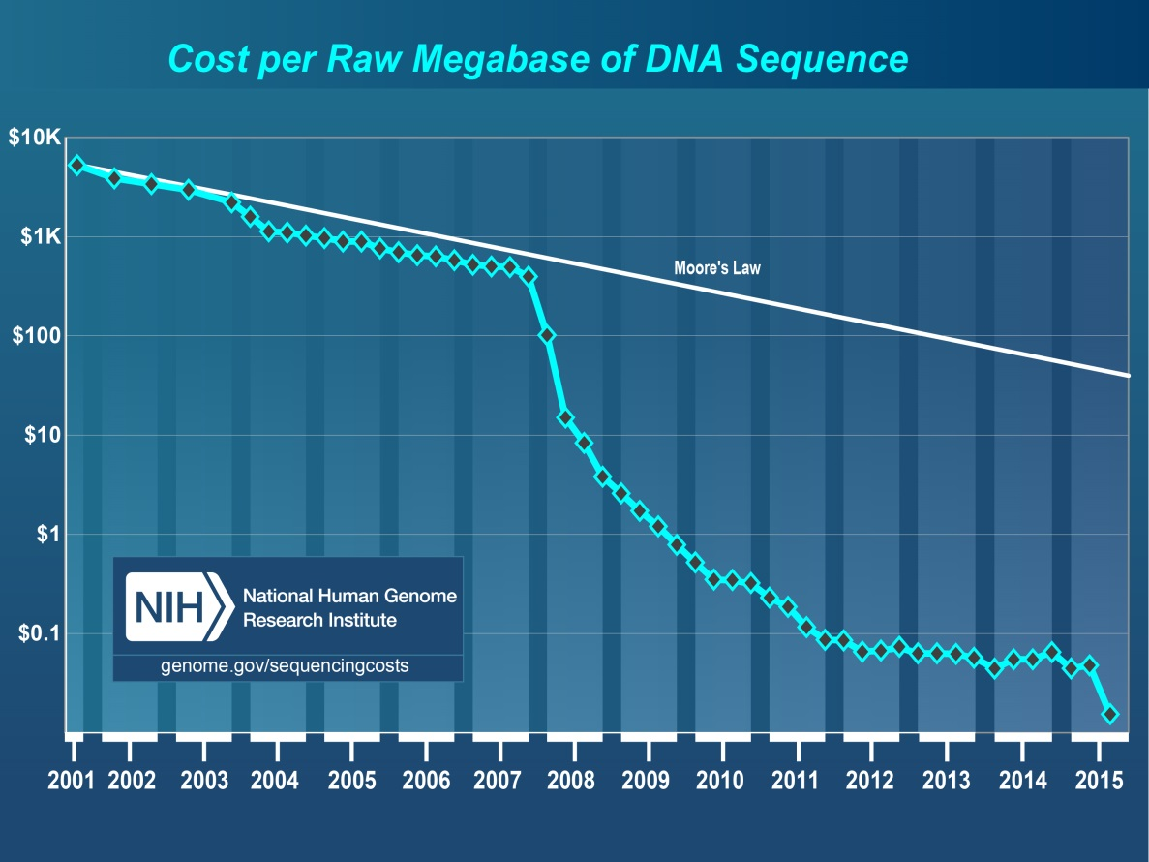
http://www.ncbi.nlm.nih.gov/
https://gold.jgi.doe.gov/
from http://sulab.org/2013/06/sequenced-genomes-per-year/
2004: NHGRI launches ‘$1000 genome’ grants

Slide 3
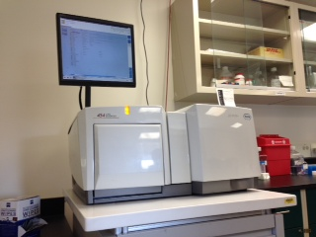
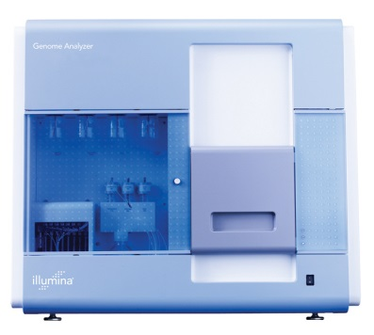
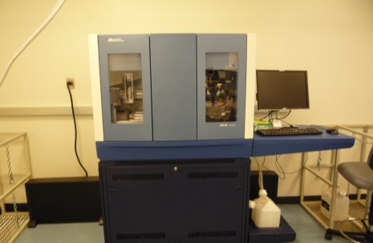
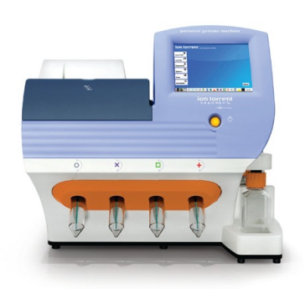
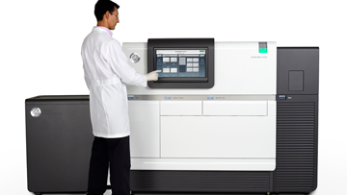
Sequencers: how they were and what they were used for
platform | # reads | max read length
Roche 454 – 2005 | 200K | 110bp
Illumina (Solexa) GA – 2006 | 30M | 35bp
ABI SOLiD – 2007 | 100M | 35bp
IonTorrent PGM – 2010 | 3M | 100bp
de-novo assembly
metagenomics
RNA-seq
ChIP-seq
re-sequencing
amplicon-seq

Slide 4
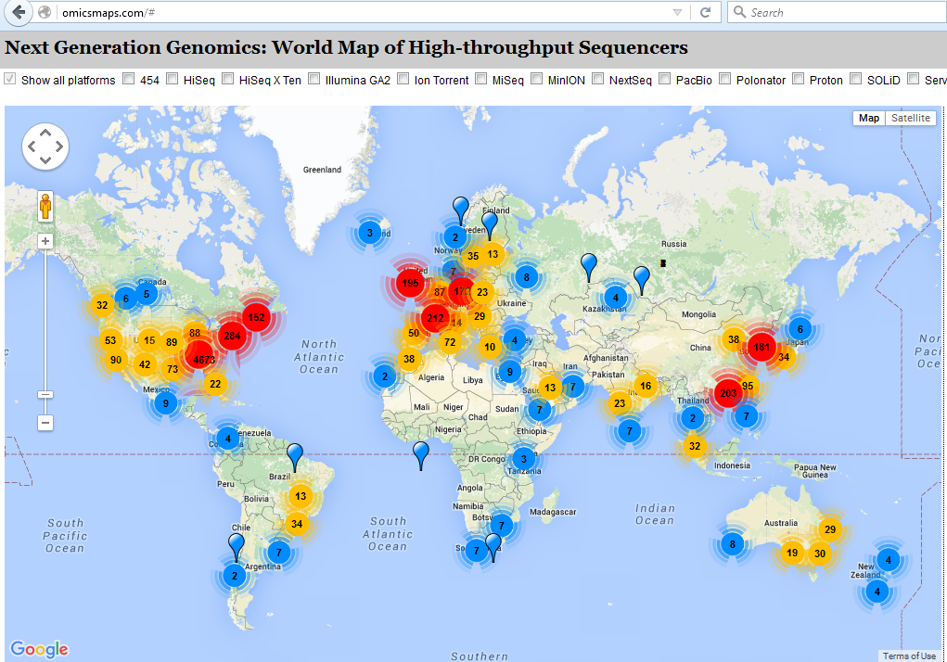

Slide 5
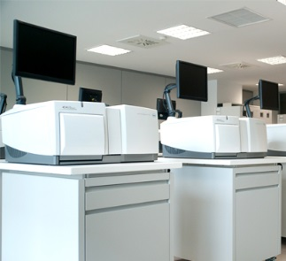
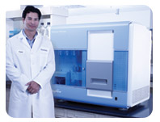
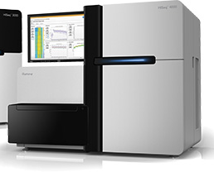
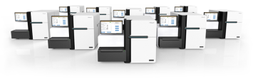
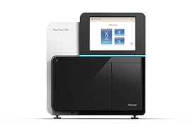
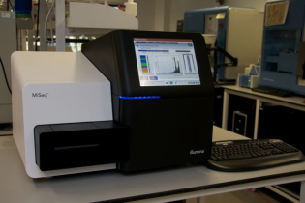
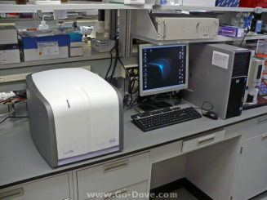

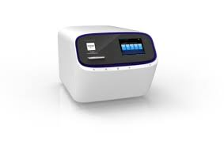
Sequencers: size and output
Roche 454 GS
Roche 454 GS FLX+
Illumina GA
Illumina HiSeq
unit
Illumina HiSeq X
Illumina NextSeq
Illumina MiSeq
bench
Illumina offers:
highest throughput per run
lowest per-base cost
IonTorrent is the fastest
Roche 454 GS Junior
Ion PGM
Ion Proton
Mb
Gb
Tb

Slide 6
Sequencers: read length
Ion PGM
Ion Proton
Illumina HiSeq
Roche 454 GS FLX+
Illumina MiSeq
250-300bp
400bp
1kb

Slide 7
Sequencers: how they are
platform | # reads | max read length
Roche | 200K | 110bp
Illumina (Solexa) | 30M | 35bp
ABI SOLiD | 100M | 35bp
IonTorrent | 3M | 100bp
Pacific Biosciences | 5K | up to 4kb
# reads | max read length
will be discontinued in 2016
5BN | 300bp
will be/is discontinued…?
80M | 400bp
50K | up to 20kb
250-300bp
400bp
1kb
>10kb

Slide 8
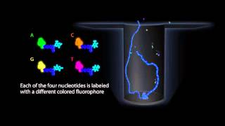
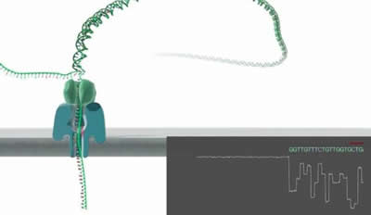
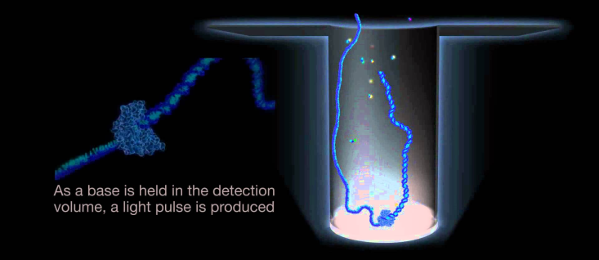
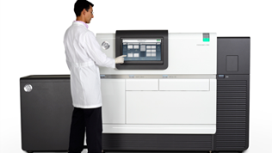

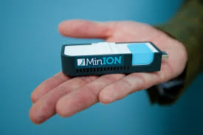


Sequencers: the real-time generation
Nanopore MinION - 2014
Pacific Biosciences (PacBio) - 2010
Ion PGM
Ion Proton
PacBio
Illumina
MiSeq
Illumina HiSeq
Roche 454 GS FLX+
Nanopore MinION
250-300bp
400bp
1kb
>10kb

Slide 9

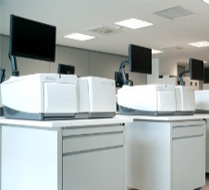
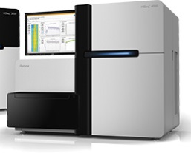
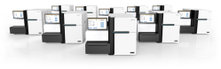

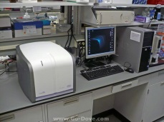

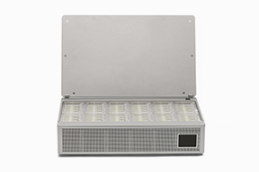
Sequencers: size and output
room
PacBio
Roche 454 GS
Roche 454 GS FLX+
Illumina GA
Illumina HiSeq
unit
Illumina HiSeq X
Illumina NextSeq
Illumina MiSeq
bench
Roche 454 GS Junior
Ion PGM
Ion Proton
Mb
Gb
Tb
Nanopore PromethION
pocket
Nanopore MinION

Slide 10
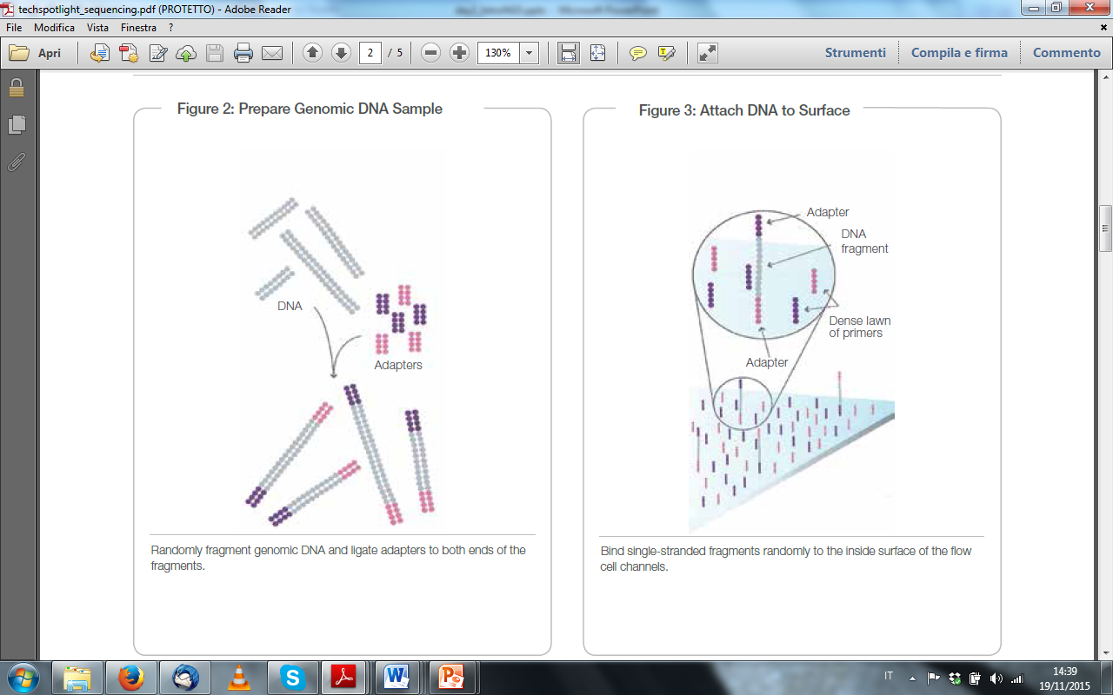
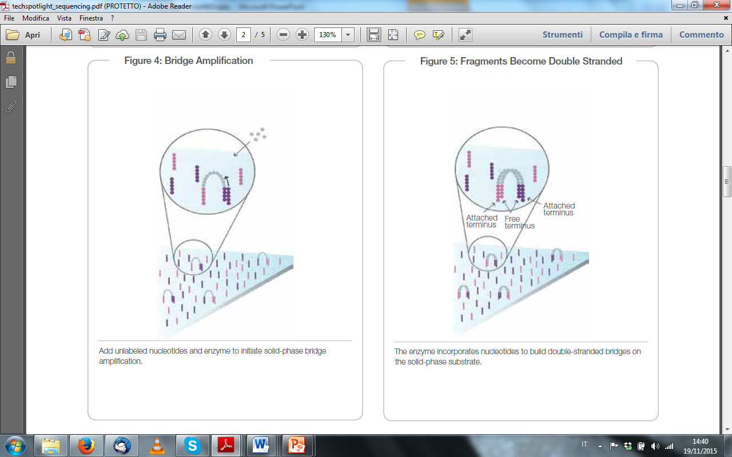
Illumina sequencing technology (1)
Sequencing by synthesis, 4 modified dNTPs together, imaging
support: slide
from https://www.illumina.com/documents/products/techspotlights/techspotlight_sequencing.pdf

Slide 11
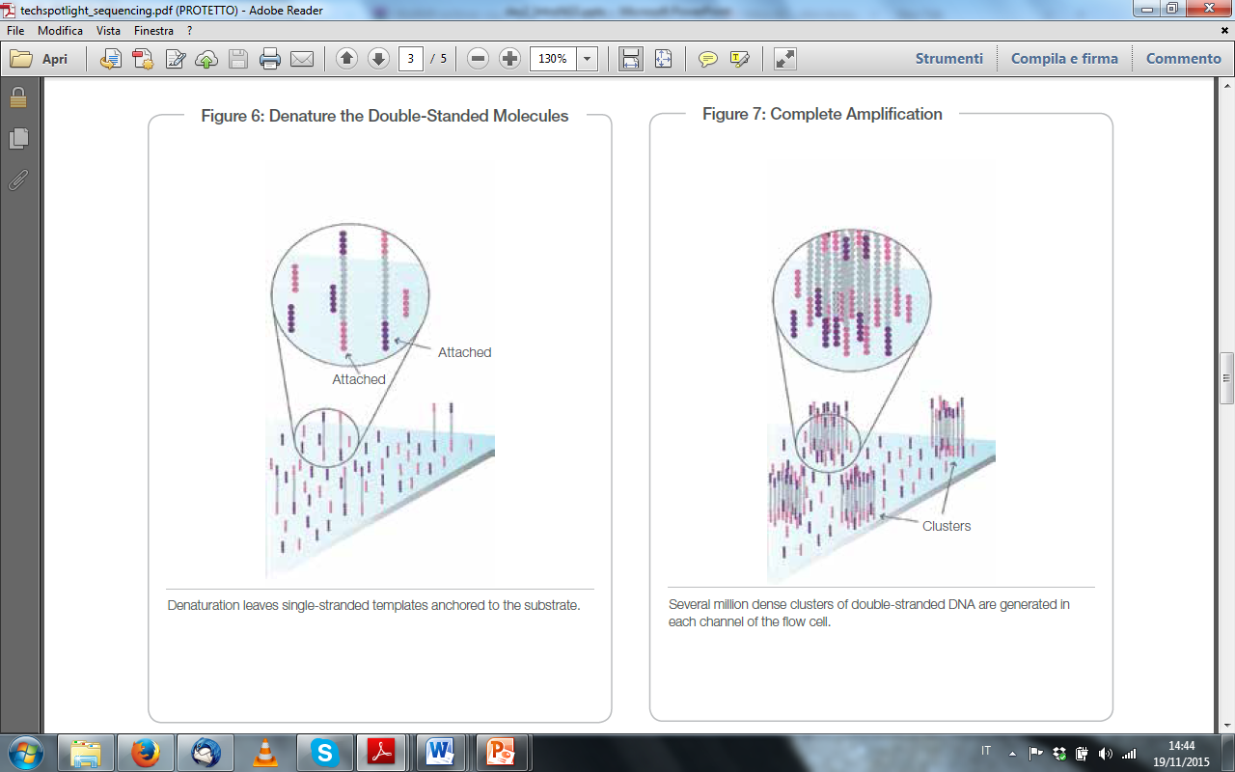
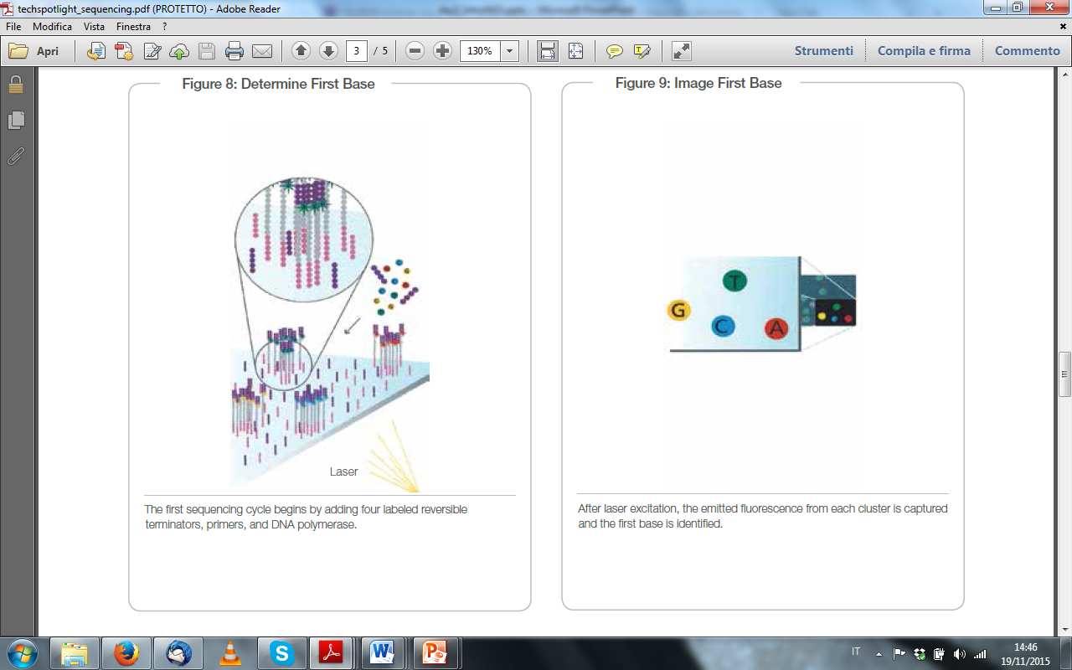
Illumina sequencing technology (2)
from https://www.illumina.com/documents/products/techspotlights/techspotlight_sequencing.pdf

Slide 12
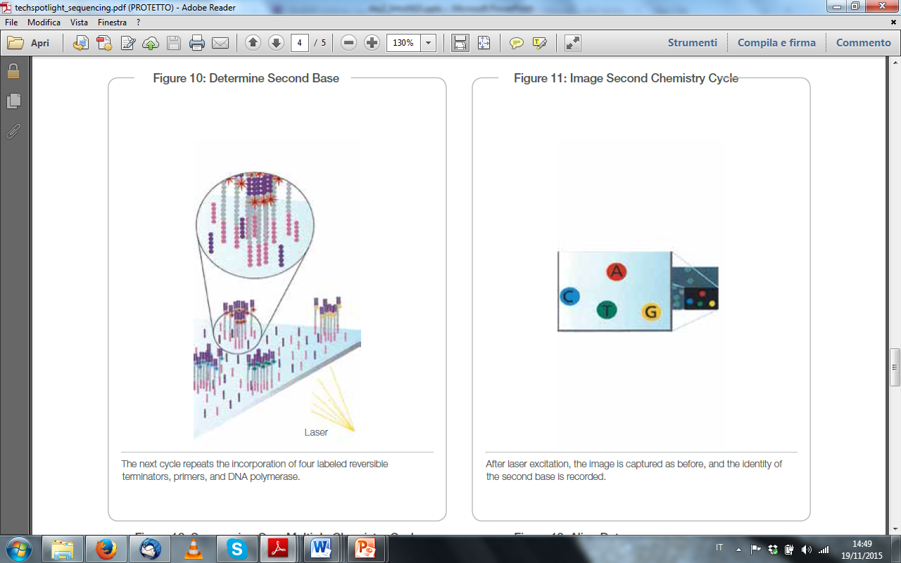
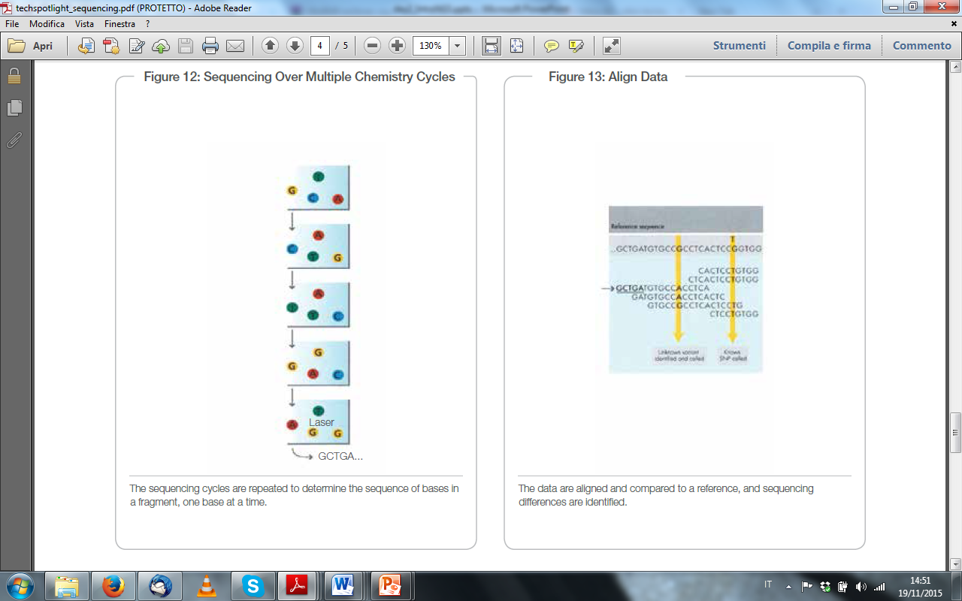
Illumina sequencing technology (3)
from https://www.illumina.com/documents/products/techspotlights/techspotlight_sequencing.pdf

Slide 13
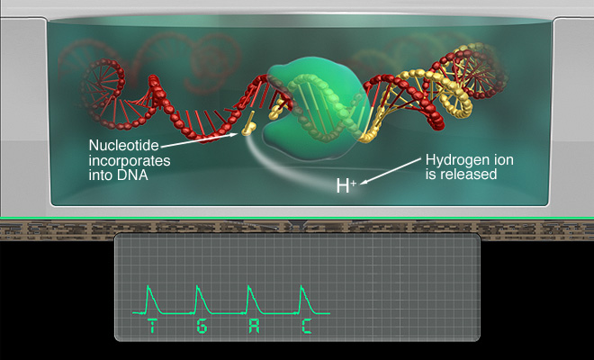
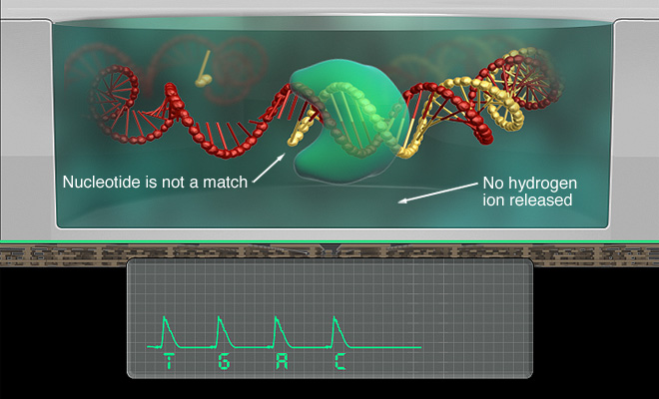
IonTorrent sequencing technology (1)
Sequencing by synthesis, 1 non-modified dNTP at the time, pH detection
support: bead/chip
from https://www.thermofisher.com/uk/en/home/life-science/sequencing/next-generation-sequencing/ion-torrent-next-generation-sequencing-technology.html

Slide 14
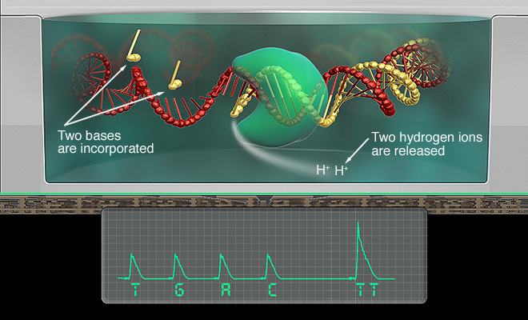
IonTorrent sequencing technology (2)
from https://www.thermofisher.com/uk/en/home/life-science/sequencing/next-generation-sequencing/ion-torrent-next-generation-sequencing-technology.html

Slide 15
Sequencers: error rates and patterns
Instrument | Primary Errors | Single-pass Error Rate (%) | Final Error Rate (%)
ABI 3730xl (capillary) | substitution | 0.1-1 | 0.1-1
Roche 454 – All models | indel | 1 | 1
Illumina – All models | substitution | ~0.1 | ~0.1
Ion Torrent – all chips | Indel | ~1 | ~1
Oxford Nanopore | deletions | ≥4* | 4*
PacBio RS | Indel | ~13 | ≤1
from http://www.molecularecologist.com/next-gen-fieldguide-2014/

Slide 16
NGS applications
Genomic DNA:
WGS (whole genome sequencing): population-scale; single-cell
WES (whole exome sequencing)
custom enrichment
amplicon-seq
RAD-seq (restriction-site-associated DNA): very useful for organisms lacking reference genomes

Slide 17
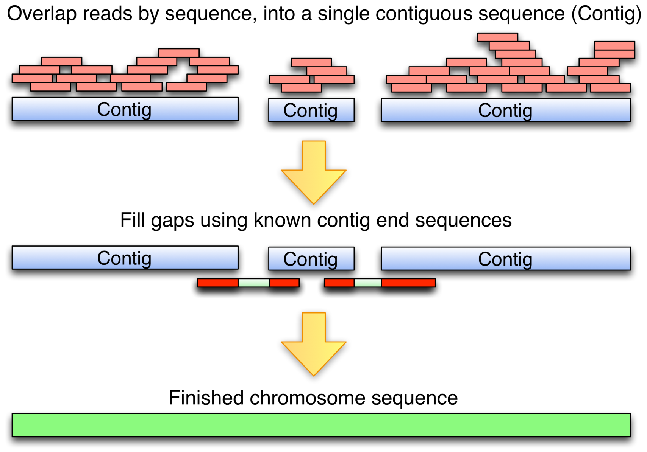
De novo assembly

Slide 18
Re-sequencing
SNP
SNP
SNP
SNP
Reference genome
Map reads to reference
Call Variants

Slide 19
What does DNA-seq tell you
Calling of known polymorphisms
Identification of novel polymorphism (SNPs, indels etc)
Genomic rearrangements, large deletions and insertions
What the genome of your sample looks like (genome assembly, chromosome assembly)

Slide 20
NGS applications
RNA-seq:
strand-specific RNA-seq protocols
single-cell transcriptomics
Fluorescent in situ RNA seq (FISSEQ): it allows the characterization of the single-cell transcriptomics and the localization of the transcripts withi the cell
CaptureSeq
Native elongating transcript seq (NET-seq)

Slide 21
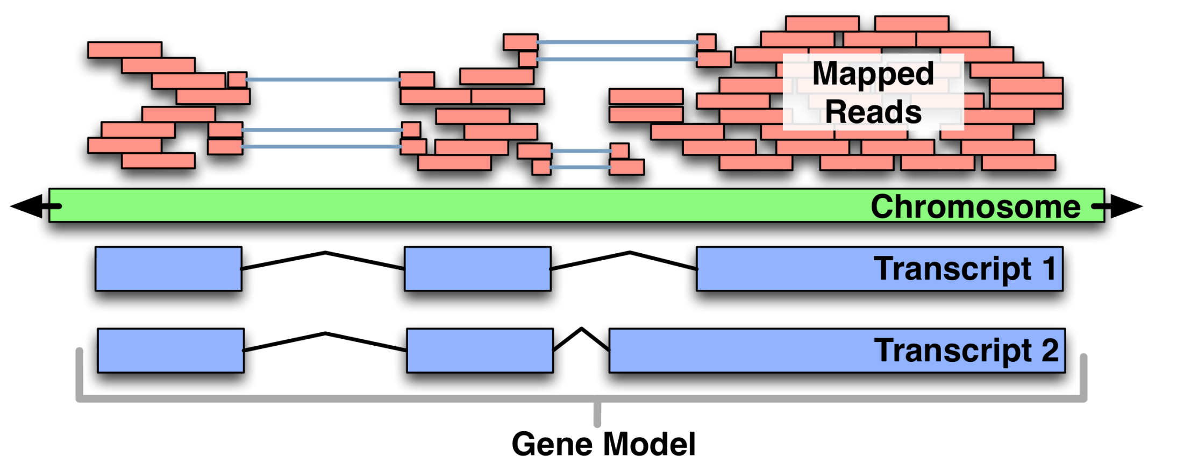
RNA-seq

Slide 22
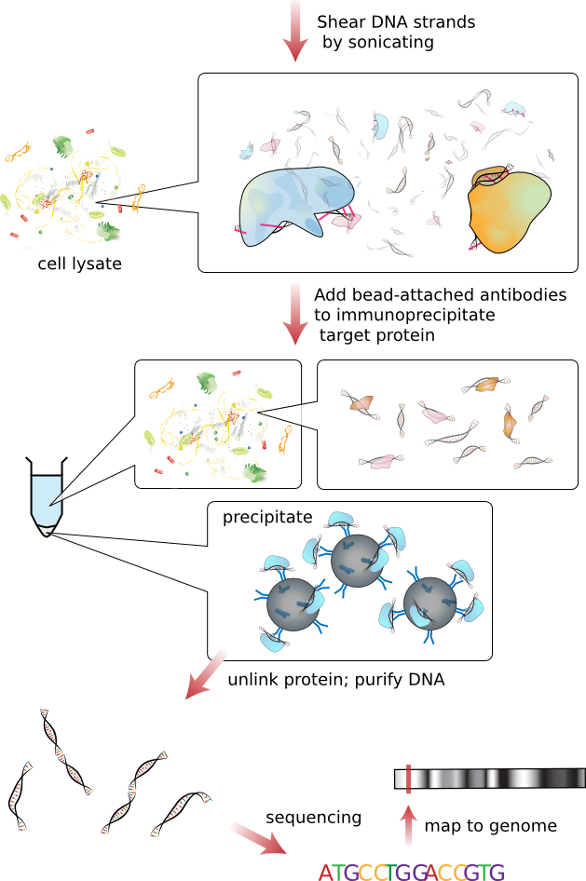
ChIP-seq
Location-based techniques
ChIP-seq: protein-DNA interactions; ChIP-exo (down to nucleotide level)
protein-RNA, RNA-DNA, DNA-DNA interactions

Slide 23
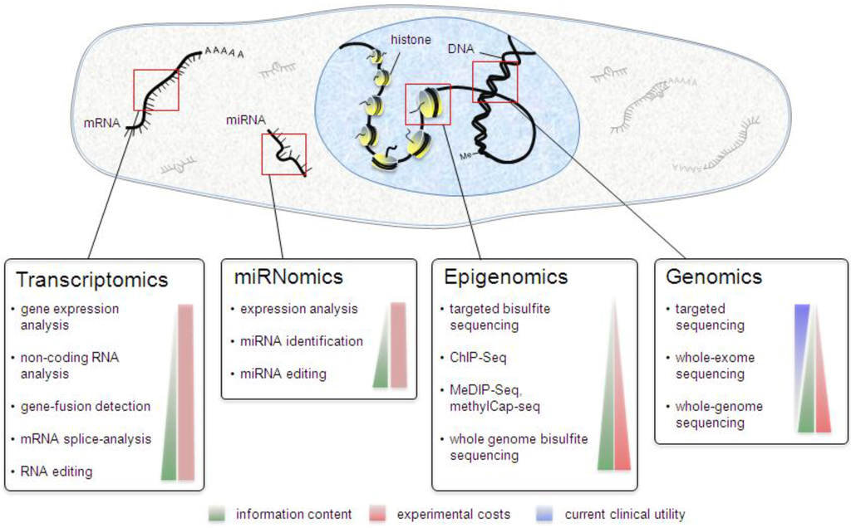
from http://www.mdpi.com/2079-7737/2/1/378/htm
Diagnostic tools in clinical laboratories; spreading in forensics
Illumina HiSeq X Ten : a human genome for less than $1000?
Personalized medicine is just around the corner…

Slide 24
So, which is the best technology?
https://docs.google.com/spreadsheets/d/1eoWVtwKvnbV8MaRb9hzCSpGtEjazO0XTt3a8TbPG4dY/edit?pli=1#gid=0
Good support and communication are essential

Slide 25
So, how do we get our DNA ready to be sequenced then?

Slide 26
DNA source and quantity
library prep
sequencing
clonal amplification

Slide 27
DNA source and quantity
non-degraded, RNA-free, high quality DNA
quality can be checked with nanodrop, specific ratios are suggested:
260/280: 1.7-2.0
260/230: >2
for quantification other methods are suggested [Qubit, picogreen]
whole genome 2ug for paired end, 20ug for mate pair
Exome 6ug or more
custom enrichment min 5ug, more depending on the target size
amplicon seq a few ng per amplicon may be enough, since PCR will increase the concentration

Slide 28
DNA source and quantity
library prep
whole genome
exome
custom enrichment
amplicon seq
RNA
shearing
adapter ligation and barcoding
size selection
amplification
quantification
sequencing
clonal amplification

Slide 29
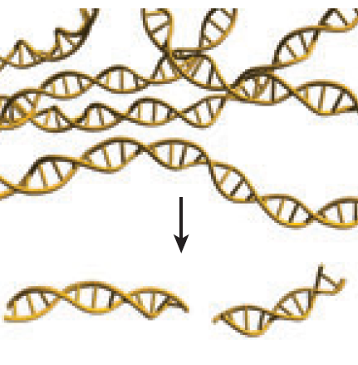
library prep - shearing
modified from Mardis 2008 Annu Rev Genomics Hum Genet 9:387-402
Two main methods are used:
Sonication: hydrodynamic shearing using acoustic energy; bubbles are formed in solution, when they explode they break the DNA
Enzymatic reaction: enzymes randomly cut the dsDNA in a time-dependent manner

Slide 30
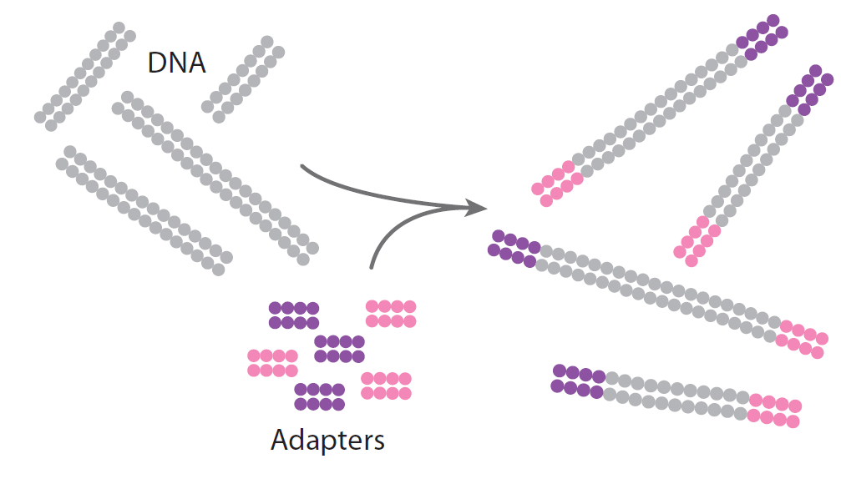
library prep – adapter ligation and barcoding
modified from Mardis 2008 Annu Rev Genomics Hum Genet 9:387-402
adapters: 30-50bp fragments which contain primer sites for amplification and are needed to link the fragment with the support (slide, bead)
barcodes/indexes: 6-10bp fragments which carry a unique sequence; they are used to distinguish samples run in the same lane/chip
Adapters and barcodes are combined into one fragment

Slide 31
library prep – size selection
Needed to select fragments of the right length from a mixture of fragments generated by the fragmentation step: it is usually 200-300bp for paired end sequencing with Illumina, but it may vary depending on the read length for 454 and IonTorrent

Slide 32


library prep – amplification
Amplification: needed to increase the concentration of the fragments which positively incorporated adapters
modified from Mardis 2008 Annu Rev Genomics Hum Genet 9:387-402

Slide 33
library prep –quantification
Quantification: needed to tune the quantity of template for the run – usually performed with the Agilent Bioanalyzer

Slide 34
DNA source and quantity
library prep
whole genome
exome
custom enrichment
amplicon seq
RNA
shearing
adapter ligation and barcoding
size selection
amplification
quantification
clonal amplification
sequencing
ePCR (IonTorrent/454)
clustering (Illumina)

Slide 35
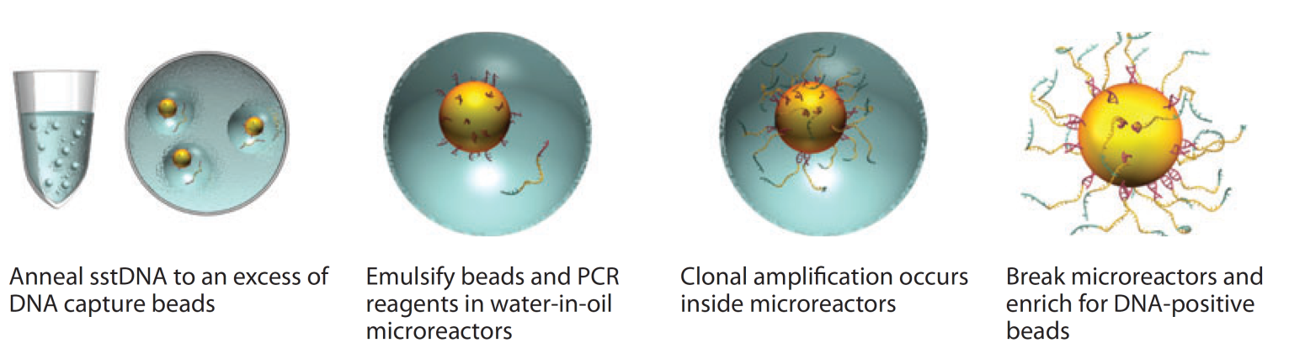
clonal amplification – ePCR (Roche 454/Ion Torrent)
modified from Mardis 2008 Annu Rev Genomics Hum Genet 9:387-402
emulsion PCR: ideally each drop contains a single fragment, PCR reagents and a bead with primers [beads may happen to be polyclonal, will be discarded after sequencing]
each bead will have one million copies of each fragment on its surface
an enrichment step is needed afterwards in order to increase the concentration of beads with attached fragments

Slide 36
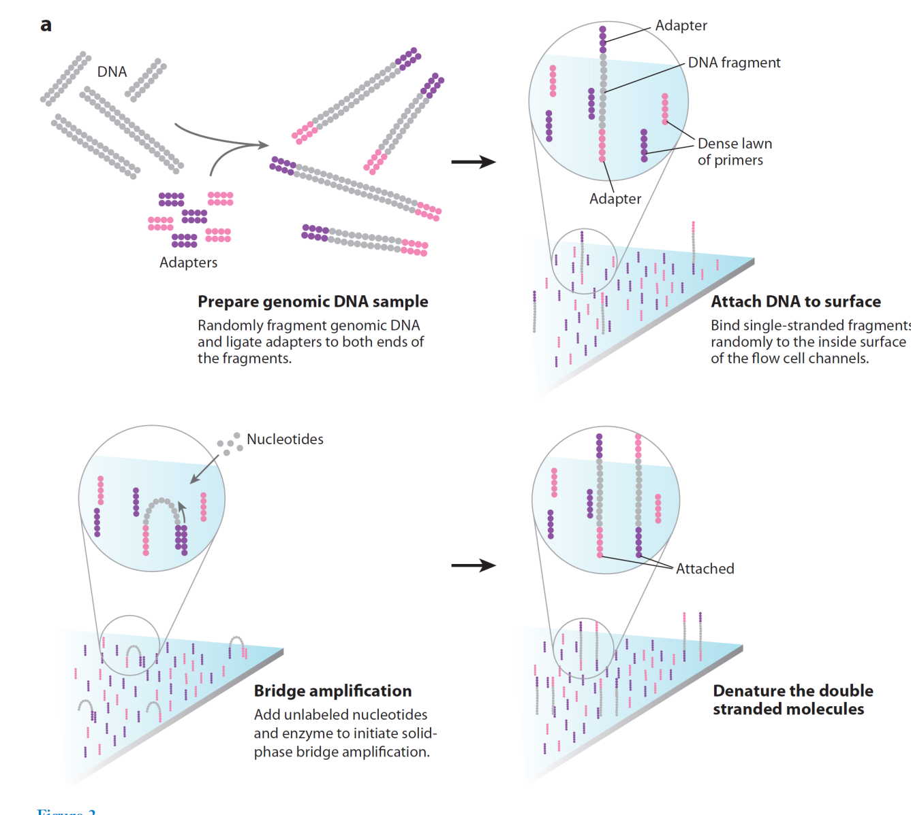
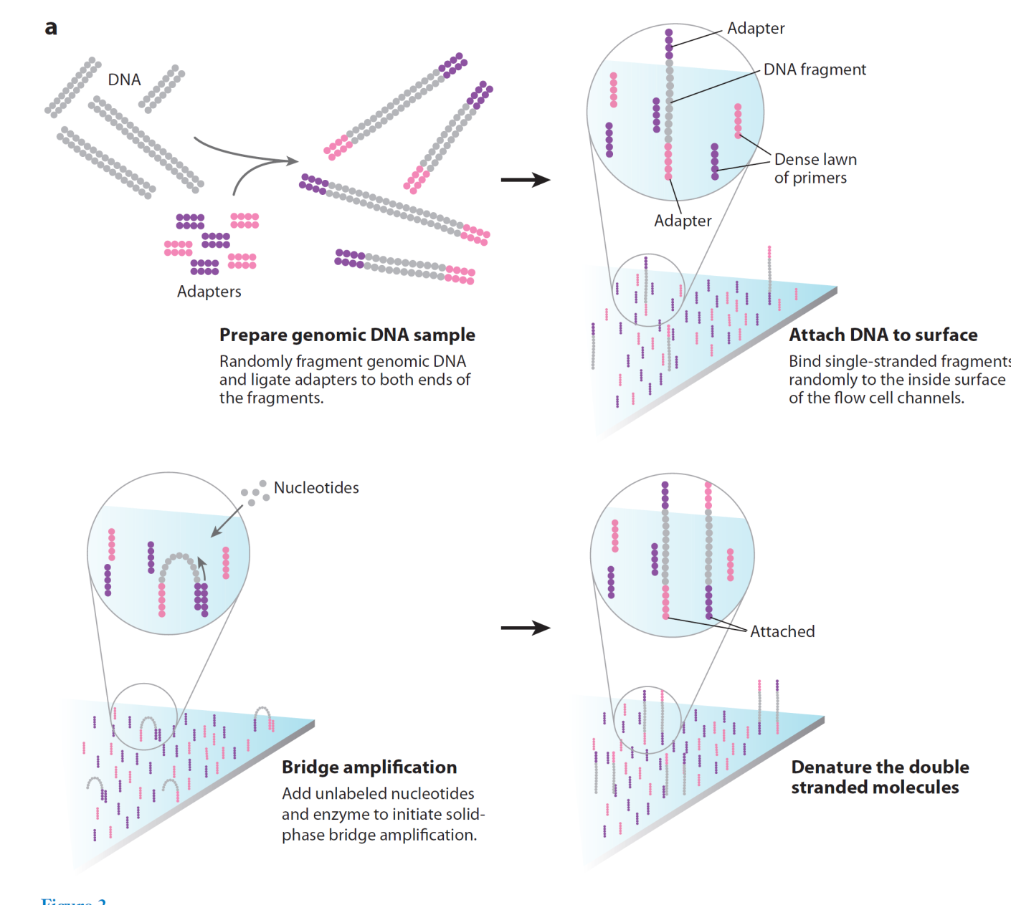

clonal amplification – clustering Illumina
modified from Mardis 2008 Annu Rev Genomics Hum Genet 9:387-402
isothermal amplification: temperature is kept constant but reagent are cycled to perform amplification, not very efficient (on purpose)

Slide 37
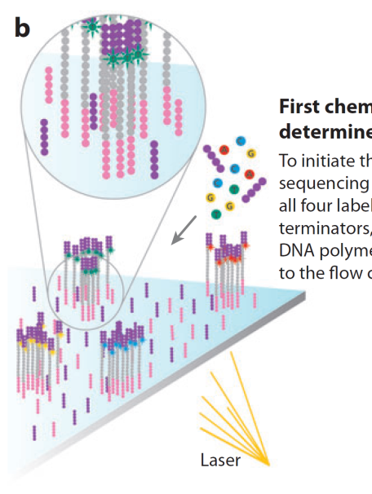
clonal amplification – clustering Illumina
modified from Mardis 2008 Annu Rev Genomics Hum Genet 9:387-402
clusters usually contain around 1000 identical copies of a single template
optimal cluster density will provide optimal sequencing output

Slide 38
A few videos…
Illumina
https://www.youtube.com/watch?v=womKfikWlxM
IonTorrent
https://www.youtube.com/watch?v=ZL7DXFPz8rU
PacBio
https://www.youtube.com/watch?v=NHCJ8PtYCFc
Oxford Nanopore
https://www.youtube.com/watch?v=3UHw22hBpAk

Slide 39

useful references and links
Mardis 2008 Annu Rev Genomics Hum Genet 9:387-402
Metzker 2010 Nat Rev Genet 11:31-46
http://seqanswers.com/forums/index.php
http://www.frontlinegenomics.com/1649/next-generation-sequencing-how-and-why-we-got-here/
http://thewestheimerinstitute.org/pubs/The%20challenges%20of%20sequencing%20by%20synthesis.pdf
http://www.molecularecologist.com/next-gen-fieldguide-2014/
Thanks to:
Pierpaolo Maisano Delser
Rita Neumann
James Eales

Slide 40
Local Realignment
Base quality recalibration
Mapping
Variant Calling
Duplicate removal
Data QC

Slide 41
Data QC
Mapping
Local Realignment
Base quality recalibration
Duplicate removal
Variant Calling

